Slide 1
PGR – Value Concordant care in the ICU

Slide 2
McFadden
Choosing Wisely critical care: goal discordant care
Discussed risks/benfits. Full code but does not want to undergo EGD due to the risk of intubation associated with the procedure.
Discussion: if surviving is your priority, due the procedure now. If you prioritize not being intubated over surviving, ok to wait.
https://twitter.com/vitaincerta/status/1334265070164070403

Slide 3
Twitter poll: from my twitter – do DNR orders (in the absence of other specified restrictions) ever applicable to patients with a pulse?
Follow-up: should every patient admitted admitted to the hospital have some variation on the discussion of “if your heart were to stop,…”
What percentage of patients do you think have
Is code status documentation: Goals of care theater? (pretending we are engaging with the question, when in fact we are not)

Slide 4
Question 1 – is this a consistent preference?
Relevant in determination of whether the patient has capacity
Gut reaction: no, either commit to maximizing chance of survival or maximizing chance of avoiding suffering.
However say you place the value of the following outcomes as: death after intubation 0/100, death without intubation 5/100, surviving with intubation, 10/100, surviving without intervention 90/100
Say ,further, I expect the chance of rebleed is 50%, and the chance of death with rebleed and out intubation is 75%. How would this play out? What is the expected value of the various decision-making strategies?

Slide 5
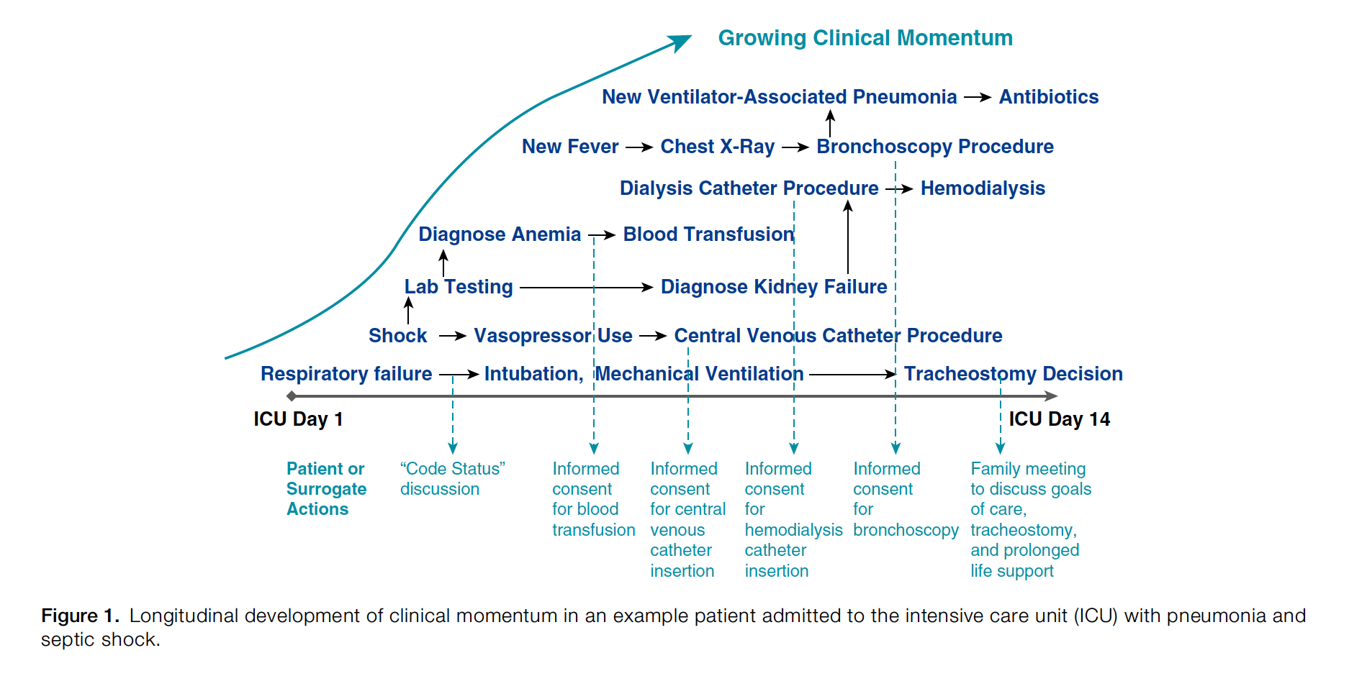
Clinical Momentum in the Intensive Care Unit
A Latent Contributor to Unwanted Care
DOI: 10.1513/AnnalsATS.201611-931OI

Slide 6
Ethical Frameworks to make decisions
Consequentialist – take the course of action that produces the best outcomes
Possibly involves disagreeing with a patient’s stated preference if it achieves their stated goals
Non-consequentialists – behave in a way in which we encourage being the type of people we would want to take care of us
E.g. deontologist – duty guided non-consequentialism
Ignoring patient’s stated preferred course of action disregards patient autonomy – which we would not want to be that type of healthcare provider.
https://plato.stanford.edu/entries/actualism-possibilism-ethics/

Slide 7
Pitfalls of deontologicalism (=actual reasoning behind commitments to individual patients, ethical normative frameworks)
Pitfalls of consequentialism (=beneficence to society, but justifies Machiavellian things)
Appealing, but in this case would argue that I should push harder to commit to a course of action that produced stated goals, even if it puts them through situations they don’t want to do. We have generally agreed not to do this in medicine.

Slide 8
Actualism vs Possibilism
You have 3 options: go to the pub, stay home and study, or stay home and watch TV. Utility of the actions are stay home and study > go to the pub > stay home and watch TV. You know, in practice, if you stay home and try to study you’ll probably watch TV. What should you do?
Actualism: go to the pub
Possibilism: stay home and study

Slide 9
How many times do we address “code status”
https://twitter.com/drsamuelbrown/status/1359353395996368897?s=12
What do patient’s remember about the care team after?

Slide 10
Was this an error?
Do you define an error based on outcomes, or based on decision-making?
Meaning, if we played our hand well (statistically), but lost - is it still an error?
Most would say no, but consider out of the 2x2 grid of options, which ones do we investigate?

Slide 11
the idea of preference-sensitive decisions
https://www.nejm.org/doi/full/10.1056/NEJMc1713344
https://www.uptodate.com/contents/ethical-issues-in-palliative-care?search=cough%20assist&topicRef=5124&source=see_link

Slide 12
Advance directives have been standardized for a good reason. Health care providers must be able to immediately understand and act on them without requiring a lawyer’s interpretation. Without the patient’s input or that of a knowledgeable surrogate, neither the patient’s reason for the nonstandard directive nor his or her present wishes concerning resuscitation can be independently known.

Slide 13
Lit review
https://www.sciencedirect.com/science/article/abs/pii/S2213260019300876
https://agsjournals.onlinelibrary.wiley.com/doi/full/10.1111/jgs.16801
https://jamanetwork.com/journals/jamanetworkopen/article-abstract/2735460
https://pubmed.ncbi.nlm.nih.gov/7474243/
https://www.bmj.com/content/340/bmj.c1345.long
https://www.atsjournals.org/doi/abs/10.1164/ajrccm.155.1.9001282
https://www.nejm.org/doi/full/10.1056/NEJMoa1802637

Slide 14
https://pubmed.ncbi.nlm.nih.gov/28099054/
https://pubmed.ncbi.nlm.nih.gov/33264125/
https://pubmed.ncbi.nlm.nih.gov/31625037/
https://pubmed.ncbi.nlm.nih.gov/21286839/

Slide 15
How do you choose who to spend time on ?
Can we predict who is at risk for mortality?
If not: how often to patients change their mind?

